Slide 1
ER Diagram
Red Jaguars

Slide 2
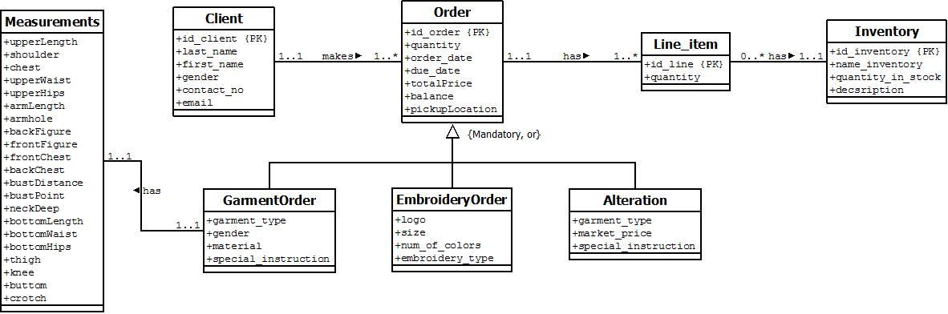

Slide 3
Proficiency Plan

Slide 4
Language
The developers of Red Jaguars have decided that Java and SQL are to be used in this project. Below are reasons why the said language is to be used
Java Programs can run regardless of Operating System
Majority of the team are familiar with the language and SQL
In order to find where the member’s proficiency in Java and SQL is, we asked all the team members to answer a survey.

Slide 5
JAVA

Slide 6
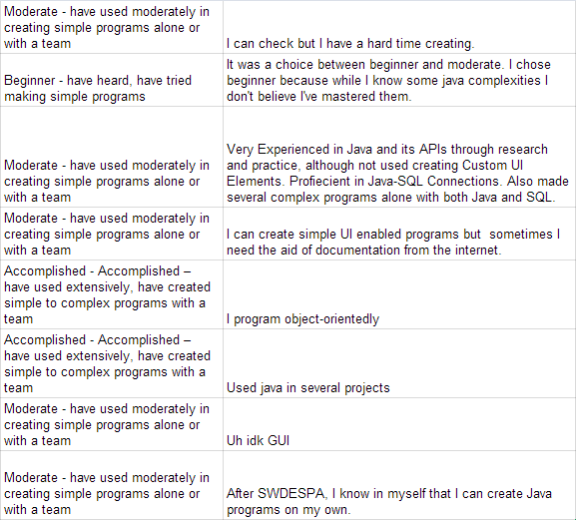

Slide 7
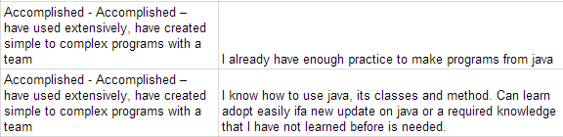

Slide 8
MySQL

Slide 9
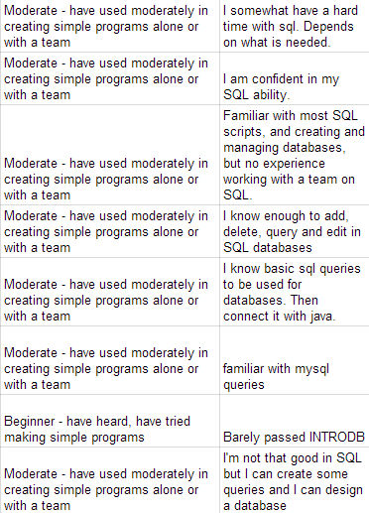
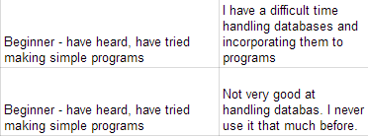

Slide 10
Goals: Java
After careful deliberation, we believe that the team should be able:
To work and communicate in teams
Apply Software Design Principles and Patterns correctly
Prioritized Patterns are MVC and Creational Patterns.
To connect SQL databases correctly and efficiently
Manipulate databases using java (add, update, delete)

Slide 11
Goals: SQL
The team should be able to:
Use SQL scripts correctly
Be able to add, update, delete tables using SQL scripts
Understand Entity-Relationship Diagrams
Connect SQL databases to Java correctly and efficiently

Slide 12
The Plan
Java Plan:
Team is divided into sub-groups
Simple programs will be assigned to groups
Programs revolve around Java-SQL Connections, MVC, and Creational Patterns
Programs in mind:
Simple Login System
Pizza Builder (or something similar)
Developers are assigned to a sub-group as a consultant

Slide 13
The Plan
SQL Plan:
Use of online reading materials
Simple exercises with SQL scripts
Tutorial Sessions
through face to face meeting
Skype / Google Hangout

Slide 14
The Plan
All group works and exercises must be submitted through a GitHub Repository on or before the assigned deadline.

